Slide 1
Problem Identification
How much are customers willing to pay for tickets at Big Mountain Resort based on the features and amenities it offers?
Should Big Mountain implement any of the proposals currently under consideration?

Slide 2
Proposals Under Consideration
Scenario 1: Close up to ten of the least popular runs.
Scenario 2: Increase the height of the vertical drop by 150 feet and add an additional lift to service the new run.
Scenario 3: Same as Scenario 2, but add 2 acres of snow-making equipment.
Scenario 4: Increase the length of the longest run by half a mile and add 4 acres of snow-making equipment.

Slide 3
Recommendations and Key Findings
Big Mountain's customers would be willing to pay anywhere from $85.48 to $106.26 for tickets.
The financial impact of Scenario 1 depends on the number of runs closed.
Scenario 2 leads to an $3,474,638 increase in yearly revenue
Scenario 3 does not offer any advantages over Scenario 2.
Scenario 4 does not lead to an increase in revenue.

Slide 4
Modelling and Analysis I
Our model suggests that customers are willing to pay a premium for seven key features:
1. The height of the vertical drop;
2. The area covered by snow-making machines;
3. The length of the longest run;
4. The size of the skiable area;
5. The total number of chairs;
6. The total number of runs;
7. The number of fast quads.

Slide 5
Modelling and Analysis II
Luckily, Big Mountain excels in these areas relative to the market.

Slide 6
Modelling and Analysis III

Slide 7
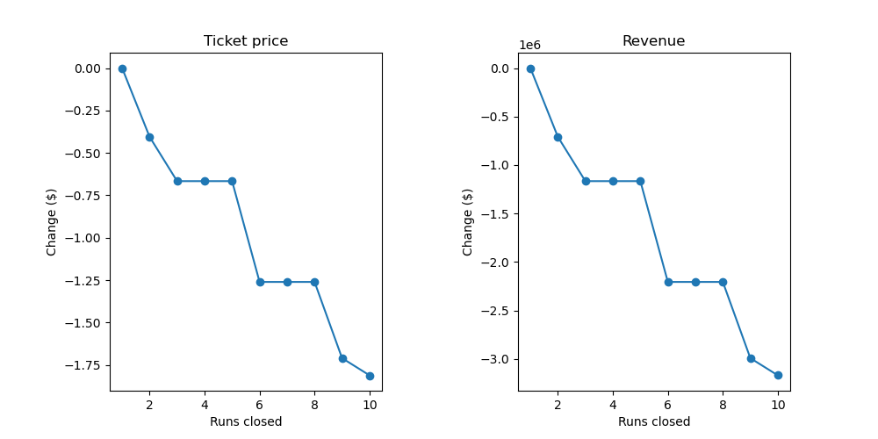
Further Insight into Scenario 1
Closing 1 run is “free”
Closing 2 runs leads to a .75 mil loss in revenue
Closing 3, 4, or 5 runs leads to a 1.2 mil loss in revenue

Slide 8
Summary and Conclusion
There’s room to increase ticket prices anywhere from $4.48 to $15.26 without making any changes to Big Mountain’s offerings.
Scenario 1 should be implemented in stages, if at all.
Scenario 2 has the most upside.
Our model can be used to explore further changes to Big Mountain’s offerings.

